Slide 1
MKTG 571:
Customer Profitability
Data Mining, Decision Trees, &
Data Analysis

Slide 2
Today’s Agenda
To discuss a data-driven customer selection model: Decision Trees
To introduce Logistic Regression and provide an example of how it is used/interpreted (analyst-driven)
To introduce Lifts and Gains as a measure of model performance

Slide 3
Decision Trees

Slide 4
Decision Trees
A machine learning algorithm:
What are the data that match this pattern?
vs.
What is the pattern that matches this data?

Slide 5
Decision Trees
A versatile data mining tool, decision trees come in many varieties - although there are two main types:
  Classification Trees
    Used for categorical dependent variable
  Regression Trees
    Used for numeric (metric) dependent variable

Slide 6
Decision Trees
Sort of like 20 Questions:
  Are you an animal? Yes
    Do you have 4 legs? No
      Do you fly? Yes
        Are you native to North America?…
In decision trees, like the game, the answer to one question determines what follow-up question is asked next.

Slide 7
Decision Trees
Decision trees are built through recursive partitioning - an iterative process of splitting the data into partitions, and then splitting it up some more
Start with the Root Node – which includes all observations (in training set)

Slide 8
Decision Trees
Each branch finds a single variable to split the data into two or more groups.
  The algorithm tries breaking up the data, using (potentially) every possible split on every variable (a brute force approach which can consume massive computing power for large datasets with lots of variables)
  For a binary tree, consider age which ranges from 18 to 94
    one split is 18 vs. everyone over 18
    then 18-19 vs. 20 or older
    then 18-20 vs. 21 or older, etc.
  The best split is the one which best separates the groups (for a classification tree) as measured by the dependent variable

Slide 9
Decision Trees
Various algorithms differ in:
  How many splits are allowed at each level of the tree
    Two or more than two
  How those splits are chosen when the tree is built
  How tree growth is limited/stopped
Total
Total
< 35
>= 35
< 35, > 70
35 - 50
51-70
Binary Tree
Multi-way Partitioning

Slide 10
Decision Trees
The Root Node contains all observations
Node A is a Child of the root and a Parent of nodes W and X
Node W is a Child of A and Parent of Y and Z
A terminal node has no children and is also called a Leaf
  Here, there are five terminal nodes: B, C, X, Y and Z
Root Node
Node A
Node B
Node C
Node W
Node X
Node Y
Node Z

Slide 11
Decision Trees
To classify or predict - an observation or data record enters the tree at the root node.
At the root a test or rule is applied to determine which child node the record will go to next.
This is repeated until the record arrives at a terminal or leaf node
There is a unique path from the root to each leaf – that path is an expression of the rule used to classify the records.
All records that end up at a given leaf of the tree are classified the same way.

Slide 12
Decision Trees
Most important goal when building models is stability
  That is, the model should make predictions that hold true when applied to unseen data
  A stable model is one that behaves similarly when applied to different sets of data
  The best model is not the one with the highest lift when it is being built - it is the model that performs best on unseen, future data.

Slide 13
Decision Trees
Collect data where outcomes are known (the model set)
A subset of the model set, the training sample, is used to build the model
  Some methods (e.g. neural networks and decision trees) may refine the model on another subset called the test set
Estimate the performance of the model, or compare the performance of several models, by using a new set, the validation or testing sample
  A normal model should do a bit better on the training sample than on the test sample, and a bit better on the test sample than the validation sample, although the performance on all should be similar.
Apply the best model to new data (the score set) where the outcome is not known. Use the predictive scores to make business decisions.
Measure performance over time, rebuild when necessary.

Slide 14
Decision Trees
Limitations:
Not as ‘precise’ as regression models
  For example, consider a metric variable like age
    in regression - the predicted value will be different for every different age (34 vs. 35 vs. 36 vs. 70, etc.)
    in a decision tree, certain ranges of age will fall into the same terminal node or leaf - so, say, 35-43 year olds may all be grouped together
Can get ‘bushy’
Can be error-prone if the number of observations per class gets small

Slide 15
Logistic Regression

Slide 16
Logistic Regression
Also known as ‘Logit’
Used when you have a binary dependent variable
  Yes – no
  Good credit risk – bad credit risk
  Buyer – not buyer
  Left - stayed (attrition/churn models)
Can include numeric and categorical predictor variables, interactions, non-linear terms
Can be extended to dependent variables with > 2 values – but this gets more complicated

Slide 17
Logistic Regression
Allows for scoring of individual customers
  Each customer gets a score -- rather than being assigned to a group
Can use any information on the customer
  including, but not limited to, R, F, and M
Can rank customers according to likelihood of purchase, response, etc.
Similar to regression - ‘interpretable’ results
  Probabilities are easily interpreted
  Can assess which variables are significant and important
  Can assess which variables have positive and negative effects on the dependent variable

Slide 18
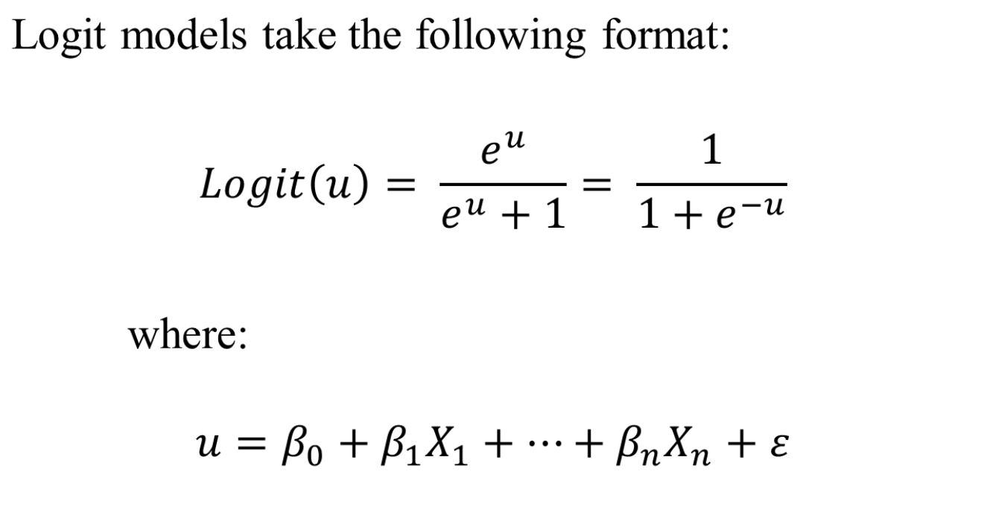
Logistic Regression

Slide 19
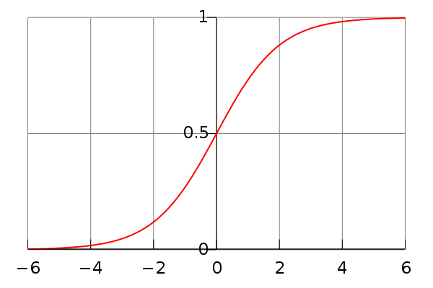
Logistic Regression
The logistic function with u on the x-axis and f(u) on the y-axis

Slide 20
Logistic Regression
Example:
  We have the results of the Senate vote of impeachment from 1998 (see Logistic Regression handout)
  We see that 55 voted not guilty (0) and 45 voted guilty (1)
  We believe the following variables will potentially help explain the vote: Political Party, % of vote Clinton received in that Senator’s state, Degree of ideological conservatism (0-100)

Slide 21
Logistic Regression
Example (cont.):
  Since we believe those 3 variables are highly correlated (and find out through running a correlation test that they are) we only choose 1 variable: Degree of conservatism (it has a lot of variance)
  Next, we run the logistic regression with Vote (guilty/not guilty) as the dependent variable as Degree of Conservatism as the independent variable.

Slide 22
Logistic Regression
We get the following results:
What did we find out?
Variable | Coefficient (β) | Standard Error | Significance
Intercept | -6.207 | 1.566 | < 0.001
CONSERV | 0.108 | 0.024 | < 0.001

Slide 23
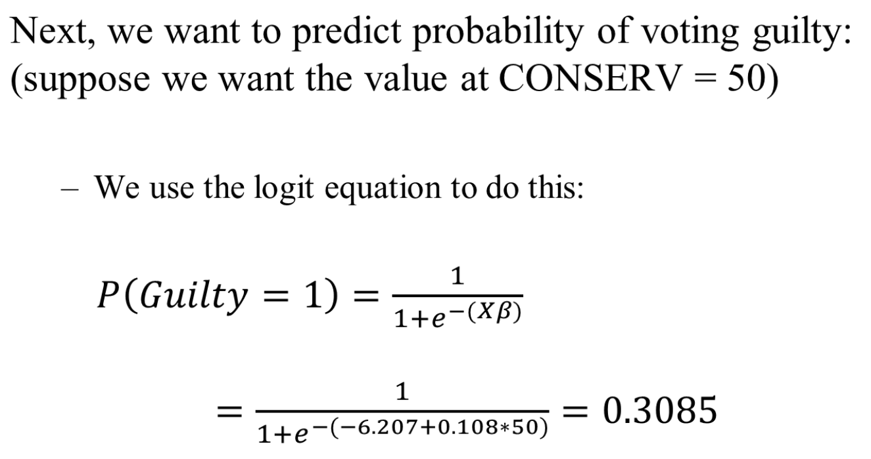
Logistic Regression

Slide 24
Logistic Regression
Now we want to interpret the coefficient in general.
  Odds: Ratio between two probabilities
  Odds Ratio: Ratio of two odds
  Computing Odds Ratio = exp(β)
  What’s the odds ratio of CONSERV?

Slide 25
Lifts and Gains

Slide 26
Lifts and Gains
Lift and Gains are useful:
  To summarize a model’s performance
  To compare the performance of two or more models
  To track a model’s performance over time
Lift is a relative measure:
  Lift demonstrates the models’ power to beat the random approach (i.e. no model)
  A lift index of 300 could refer to a predicted 3% response rate or a predicted 90% response rate - depending on whether the response rate for the general population is 1% of 30%.
Gains is an absolute measure:
  Example: by targeting X% of the customers, I can reach Y% of the buyers

Slide 27
Lifts and Gains
Lift
  (response rate for that decile/overall response rate) * 100
Cumulative Lift
  (cumulative response rate up through that decile/overall response rate) * 100
Gains
  Proportion of buyers/responders in that decile/group
Cumulative Gains
  Sum of gains up to and including that decile/group

Slide 28
Lifts and Gains
Example:
  What are the lifts and gains for BookBinders when the customers are sorted by Recency?
  We start by sorting them into deciles (note there are only 9 given that Recency has very little variation)

Slide 29
Lifts and Gains
Decile | # Customers | # Buyers
1 | 3,748 | 670
2 | 7,424 | 1,058
3 | 3,820 | 459
4 | 6,254 | 638
5 | 6,158 | 521
7 | 6,229 | 474
8 | 6,184 | 389
9 | 5,346 | 203
10 | 4,837 | 110
Total | 50,000 | 4,522

Slide 30
Lifts
Decile | # Customers | Cumulative # Customers | Cumulative % Customers | # Buyers | Cumulative # Buyers | Response Rate | Lift | Cumulative Response Rate | Cumulative Lift
1 | 3,748 | 3,748 | 7.5% | 670 | 670 | 17.88% | 198 | 17.88% | 198
2 | 7,424 | 11,172 | 22.3% | 1,058 | 1,728 | 14.25% | 158 | 15.47% | 171
3 | 3,820 | 14,992 | 30.0% | 459 | 2,187 | 12.02% | 133 | 14.59% | 161
4 | 6,254 | 21,246 | 42.5% | 638 | 2,825 | 10.20% | 113 | 13.30% | 147
5 | 6,158 | 27,404 | 54.8% | 521 | 3,346 | 8.46% | 94 | 12.21% | 135
7 | 6,229 | 33,633 | 67.3% | 474 | 3,820 | 7.61% | 84 | 11.36% | 126
8 | 6,184 | 39,817 | 79.6% | 389 | 4,209 | 6.29% | 70 | 10.57% | 117
9 | 5,346 | 45,163 | 90.3% | 203 | 4,412 | 3.80% | 42 | 9.77% | 108
10 | 4,837 | 50,000 | 100% | 110 | 4,522 | 2.27% | 25 | 9.04% | 100
Total | 50,000 | 100% |  | 4,522 |  | 9.04%

Slide 31
Gains
Decile | # Customers | Cumulative # Customers | Cumulative % Customers | # Buyers | Cumulative # Buyers | Gains | Cumulative Gains
1 | 3,748 | 3,748 | 7.5% | 670 | 670 | 15% | 15%
2 | 7,424 | 11,172 | 22.3% | 1,058 | 1,728 | 23% | 38%
3 | 3,820 | 14,992 | 30.0% | 459 | 2,187 | 10% | 48%
4 | 6,254 | 21,246 | 42.5% | 638 | 2,825 | 14% | 62%
5 | 6,158 | 27,404 | 54.8% | 521 | 3,346 | 12% | 74%
7 | 6,229 | 33,633 | 67.3% | 474 | 3,820 | 10% | 84%
8 | 6,184 | 39,817 | 79.6% | 389 | 4,209 | 9% | 93%
9 | 5,346 | 45,163 | 90.3% | 203 | 4,412 | 4% | 98%
10 | 4,837 | 50,000 | 100% | 110 | 4,522 | 2% | 100%
Total | 50,000 | 100% |  | 4,522

Slide 32
For Next Class
Topic:
  Turning Raw Data into Managerial Insights
Reading:
  None
Assignment:
  Individual: Predicting Response at BookBinders: Logistic Regression

Slide 33
Appendix Slides
Additional information for Decision Trees

Slide 34
Decision Trees
A model is only as good as the data used to create it.
Sample should include the same values and ranges that are in the population
In general, bigger model sets are better except when
  There is a trade-off with time which could be better spent investigating other parameters, deriving new variables, etc.
  We are trying to predict a rare event - such as fraud or probability of responding to direct mail
    Density = # rare outcomes/# total outcomes
    Say a rare outcome occurs in 1 percent of the observations
    A model build with 50,000 observations and a density of 20 percent may produce better results than the one built with a million observations and a density of 1 percent
    We can control density by using oversampling

Slide 35
Decision Trees
When what you are trying to predict occurs rarely – it is difficult to build a model to predict it
  If 99% don’t respond – are innocent – are good risks – don’t have the disease – then you will be right 99% of the time if you predict that everyone won’t respond, is innocent, a good risk, and healthy ---- but….
Oversampling uses a data set with more of the rare outcomes and fewer of the common outcomes. Oversampling increases the frequency of the less common outcomes.
  When there are only two outcomes, we typically want the rare outcome to occur in about 10-40% of the data.
Reducing the size of the dataset to where there are a more balanced number of rare outcomes vs. common outcomes helps the algorithms produce a good model.

Slide 36
Decision Trees
Segmentation
  Identify relatively homogeneous groups
Classification
  Assign cases into one of two or more categories
Prediction
  Like regression, predict values of a target variable
Data reduction/variable screening
  Identify a useful subset of predictors from a large set - for use in a model such as regression
Interaction Identification
  Identify relationships that pertain only to specific subgroups – for use in a model such as regression

